Slide 1
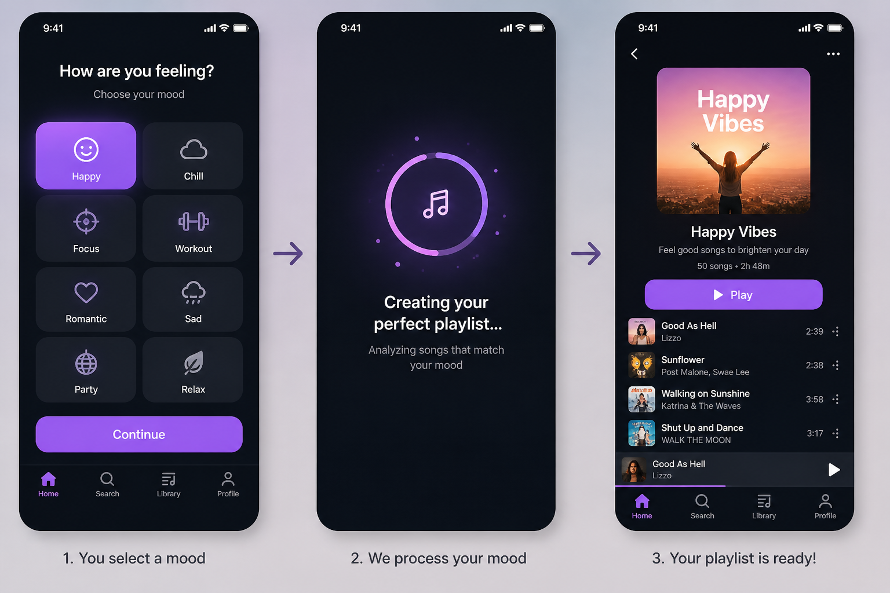
Mix My Mood – Playlist Generator
Crafting Playlists To Match Your Every Emotion
Yamilex Morales

